Slide 1
Assignment
Data Science - EDA
Deepak S

Slide 2
Importing basic modules
import pandas as pd
import matplotlib.pyplot as plt
import seaborn as sns
import numpy as np
df = pd.read_csv(r"C:\Users\sgdee\OneDrive\Documents\Finlatics - Data Science Experience Program\Assignments\DsResearch\Media and Technology\Media and Technology\Global YouTube Statistics.csv", encoding = 'latin-1')
print(df.head())

Slide 3
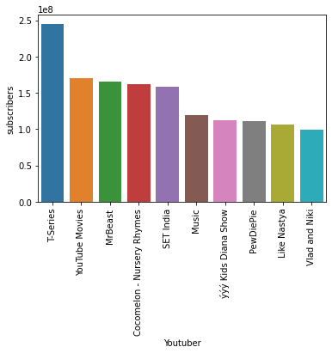
1. What are the top 10 YouTube channels based on the number of subscribers ?
df_sorted = df.sort_values(by=['subscribers'], ascending=False)
top_channels = df_sorted[['Youtuber','subscribers']].head(10)
print(top_channels)
sns.barplot(data = top_channels, x = 'Youtuber', y= 'subscribers')

Slide 4
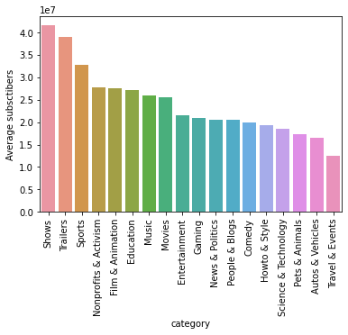
2. Average of the subscribers grouped by category and order by descending to display the highest
category_subscribers = pd.DataFrame(df.groupby('category')['subscribers'].mean().sort_values(ascending=False))
sns.barplot(data = category_subscribers, x = 'category', y= 'subscribers')
plt.xticks(rotation = 90)

Slide 5
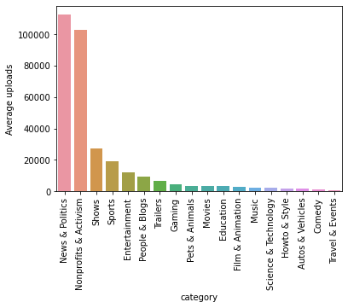
3. How many videos, on average, are uploaded by YouTube channels in each category?
upload_category = pd.DataFrame(df.groupby("category")['uploads'].mean().sort_values(ascending = False)).reset_index()
sns.barplot(data = upload_category, x = 'category', y= 'uploads')
plt.xticks(rotation = 90)
plt.ylabel("Average uploads")
print(upload_category)

Slide 6
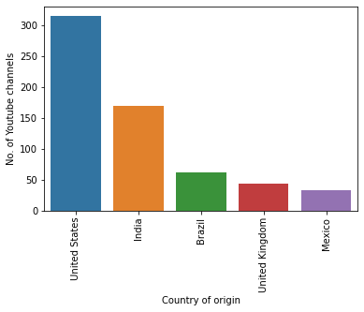
4. What are the top 5 countries with the highest number of YouTube channels?
channels_country = pd.DataFrame(df.groupby('Country of origin')['Title'].count().sort_values(ascending = False)).reset_index()
print(channels_country)
sns.barplot(data = channels_country.head(5), x = 'Country of origin', y= 'Title')
plt.ylabel("No. of Youtube channels")
plt.xticks(rotation = 90)

Slide 7
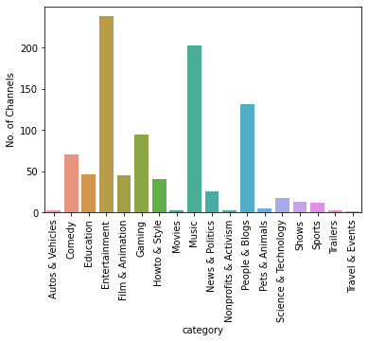
5. What is the distribution of channel types across different categories ?
hist_data = pd.DataFrame(df.groupby('category')['Title'].count()).reset_index()
sns.barplot(data = hist_data, x = 'category', y= 'Title')
plt.xticks(rotation = 90)
plt.ylabel("No. of Channels")

Slide 8

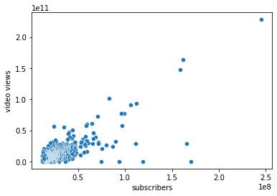
6. Is there a correlation between the number of subscribers and total video views for YouTube channels ?
corr_data = df[['subscribers','video views']]
print(corr_data.corr())
sns.scatterplot(corr_data, x = 'subscribers', y = 'video views')

Slide 9
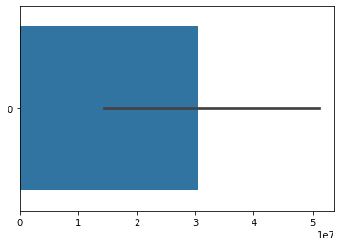
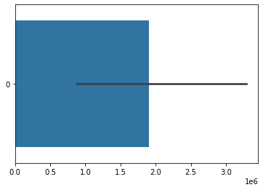
7. How do the monthly earnings vary throughout different categories?
plt.figure()
hist_high_earnings = df.groupby('category')['highest_monthly_earnings'].sum().sort_values()
sns.barplot(data = hist_high_earnings, orient = 'h')
plt.figure()
hist_high_earnings = df.groupby('category')['lowest_monthly_earnings'].sum().sort_values()
sns.barplot(data = hist_high_earnings, orient = 'h')

Slide 10
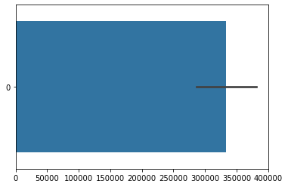
8. What is the overall trend in subscribers gained in the last 30 days across all channels?
sub_data = df.groupby('category')['subscribers_for_last_30_days'].mean().sort_values()
sns.barplot(data = sub_data, orient = 'h')

Slide 11
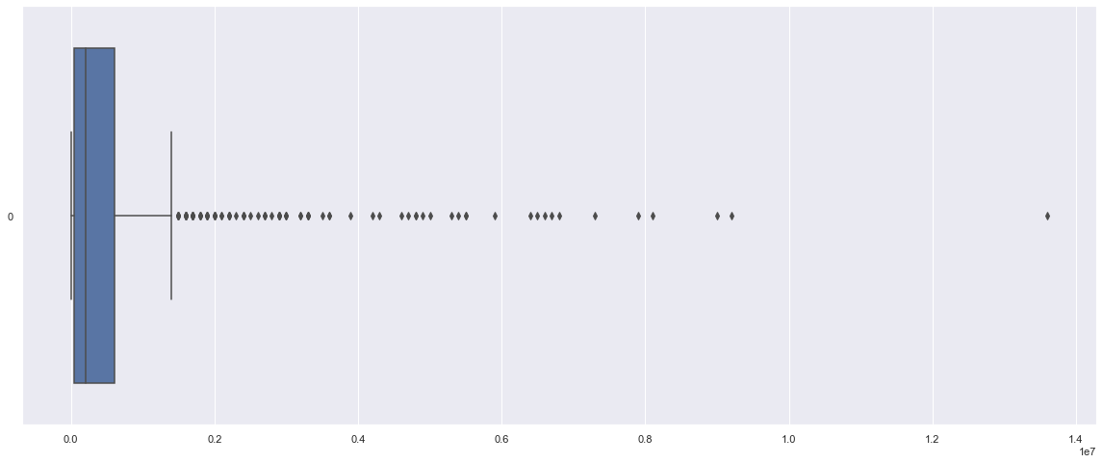
9. Are there any outliers in terms of yearly earnings from YouTube channels?
width = 20
height = 8
sns.set(rc = {'figure.figsize':(width, height)})
sns.boxplot(data = df['highest_monthly_earnings'], orient = 'h')

Slide 12
10. What is the distribution of channel creation dates? Is there any trend over time?
sns.displot(df['created_date'])
plt.close()
time_trend = df.groupby('created_year')['Title'].count().sort_values()
sns.barplot(data = time_trend)

Slide 13
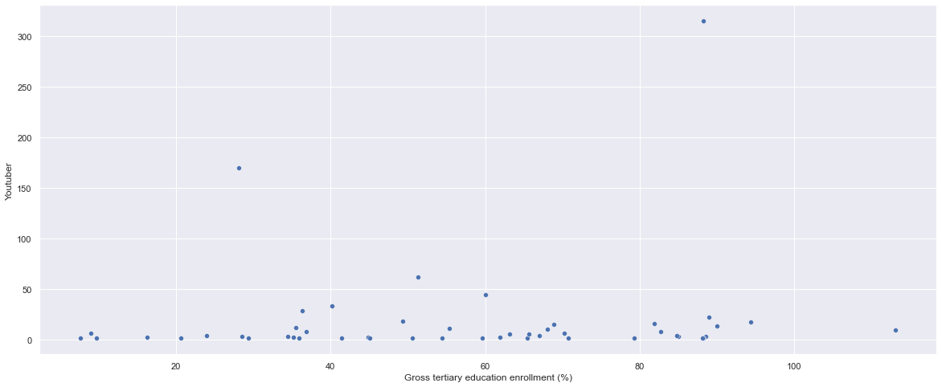
11. Is there a relationship between gross tertiary education enrollment and the number of YouTube channels in a country?
youtuber_data = df.groupby('Country of origin')['Youtuber'].count()
employment_data = df.groupby('Country of origin')['Gross tertiary education enrollment (%)'].max()
youtuber_data = pd.DataFrame(youtuber_data)
employment_channel_data = youtuber_data.merge(employment_data, on = 'Country of origin')
employment_channel_data.corr()
sns.scatterplot(data = employment_channel_data, x = 'Gross tertiary education enrollment (%)', y = 'Youtuber')

Slide 14
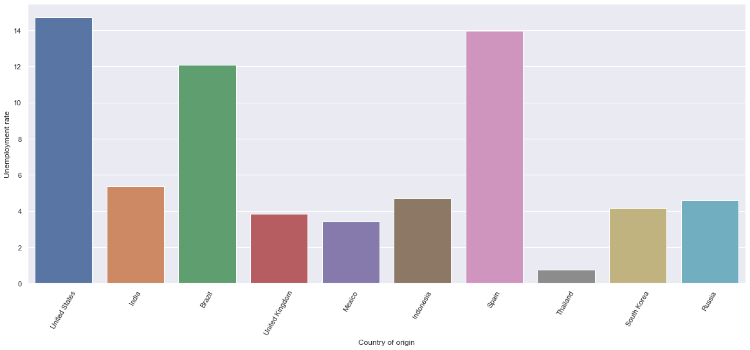
12. How does the unemployment rate vary among the top 10 countries with the highest number of YouTube channels?
um_employ_data = pd.DataFrame(df.groupby('Country of origin')['Unemployment rate'].max().sort_values())
youtuber_data = pd.DataFrame(df.groupby('Country of origin')['Youtuber'].count().sort_values())
merge_data = um_employ_data.merge(youtuber_data, on = 'Country of origin')
plot_data = merge_data.sort_values(by = 'Youtuber', ascending = False).head(10).reset_index()
sns.barplot(x = 'Country of origin', y = 'Unemployment rate', data = plot_data)
plt.xticks(rotation = 60)

